Slide 1
Comparison between Statistical Method and Machine Learning Method for Downscaling
Candidate Number: YQNN3

Slide 2
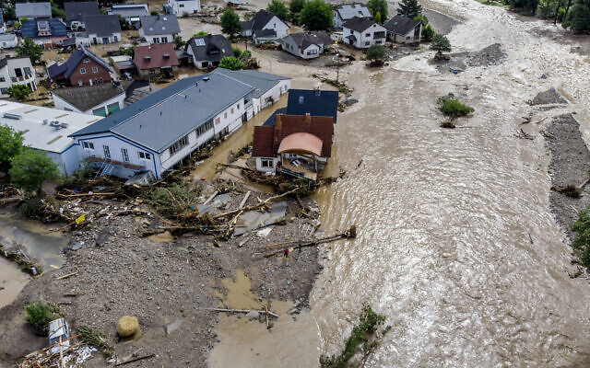
2021 European Flood
Jordans (2021)

Slide 3
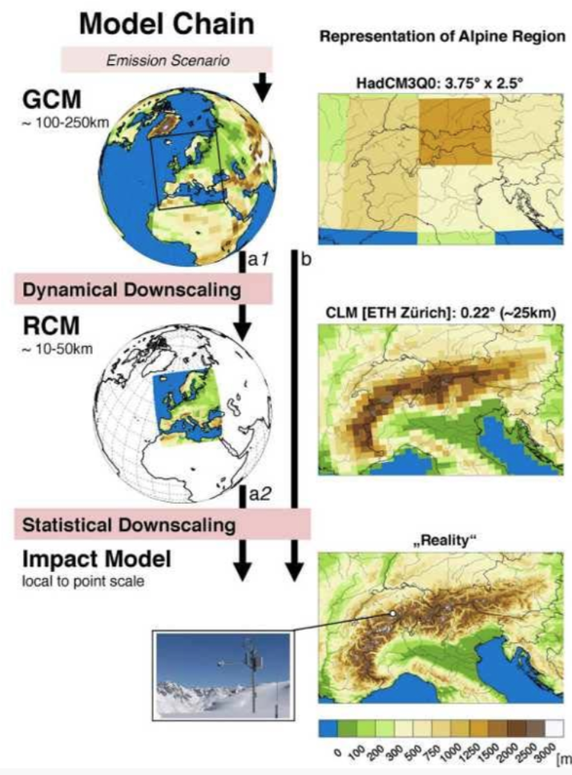
Downscaling
Resolution of Global Climate Models (GCMs) is too coarse
Downscaling methods are developed to obtain local-scale weather
Statistical downscaling:
Statistical Relationship
Large-scale variables
Local-scale variables
Dierickx (2019)

Slide 4
Aim: compare statistical method and machine learning method for downscaling
Downscaling Methods Used in the Study:
Downscaling
Method
Statistical Method
Machine Learning Method
Bayesian Network
Generalised Linear Model (GLM)
Random Forest

Slide 5
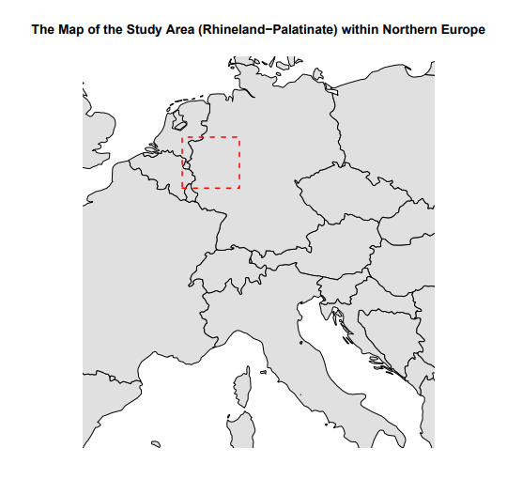
Case Study
Year range: 1959 – 2022
87 stations
1,113,429 observations
Daily precipitation and temperature data
Topographic data
Geographical data for the stations
Daily large-scale atmospheric data

Slide 6
GLM
Extension of the linear regression model
Package used: Rglimclim (Chandler, 2018)
Response variables: precipitation and temperature
Covariates: seasonality, regional variation, autocorrelation, large-scale atmospheric predictors, interactions
Model structures: logistic regression for precipitation occurrence (19 covariates and 29 interactions)
gamma for precipitation amount (17 covariates and 22 interactions)
normal-heteroscedastic for temperature (17 covariates and 33 interactions)

Slide 7
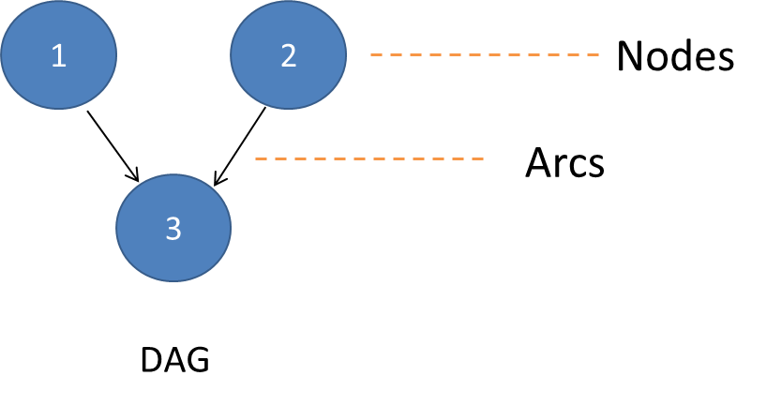
Bayesian Network
Probabilistic graphical model
represents variables and their conditional dependencies using a directed acyclic graph (DAG)
Nodes represent variables, arcs represent dependence relationship
Package used: BNWeatherGen (Legasa and Guti ́errez, 2020)
Predictands: precipitation occurrence
Predictors: geographical data for the stations
It learns the spatial structure and temporal structure, then generates weather series by an iterative process with ancestral order.

Slide 8
Random Forest
Classification and regression trees (CART) divide the predictor space into regions that are homogeneous with respect to the response variable
Random forest combines multiple CARTs
A posterior random forest which can estimate the shape and scale the parameters of the probability distribution Y|X
Package used: RandomForestDist (Legasa et al., 2022)
Predictands: precipitation amount and temperature
Predictors: large-scale atmospheric variables
Model structures: gamma for precipitation amount
normal for temperature

Slide 9
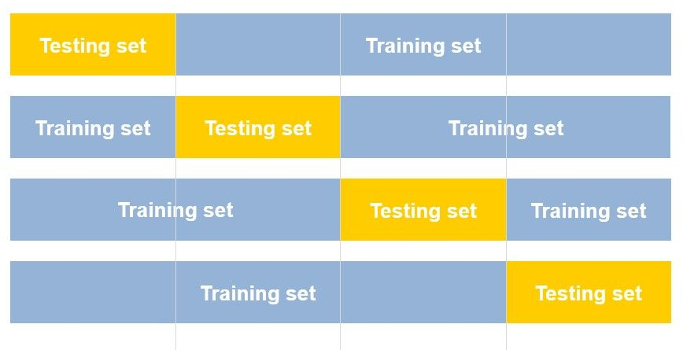
Four-fold Cross-validation
Divide the time period (from 1959 to 2022) into 4 folds:
F1 = 1959-1974, F2 = 1975-1990,
F3 = 1991-2006, F4 = 2007-2022
The model is trained 4 times, each time:
validated by 1 fold
trained by the remaining 3 folds
Iteration 1
Iteration 2
Iteration 3
Iteration 4
F1
F2
F3
F4
(Automatiserad Machine Learning | Softronic AB, 2021)

Slide 10
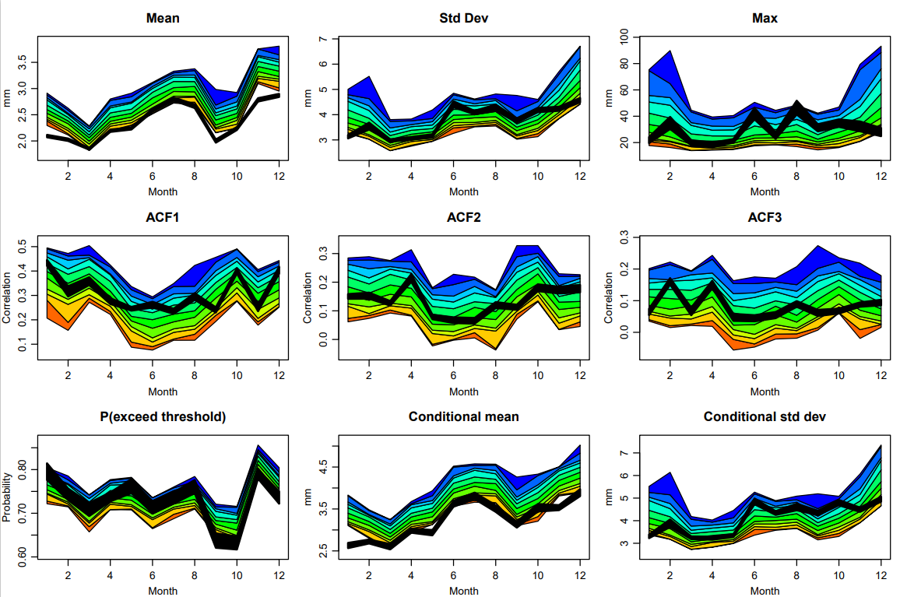
Precipitation Simulation Results from Statistical Method
Simulated means and means on wet days are overestimated
Other statistics of simulations generally match the observations well

Slide 11
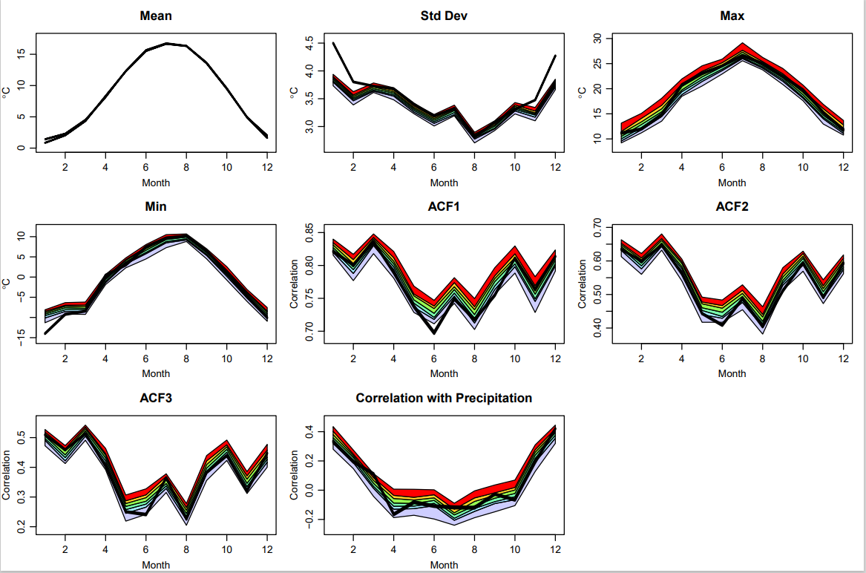
Temperature Simulation Results from Statistical Method
Simulated standard deviations are underestimated in some months
Simulated minimums are overestimated in some months
Other statistics of simulations generally match the observations well

Slide 12
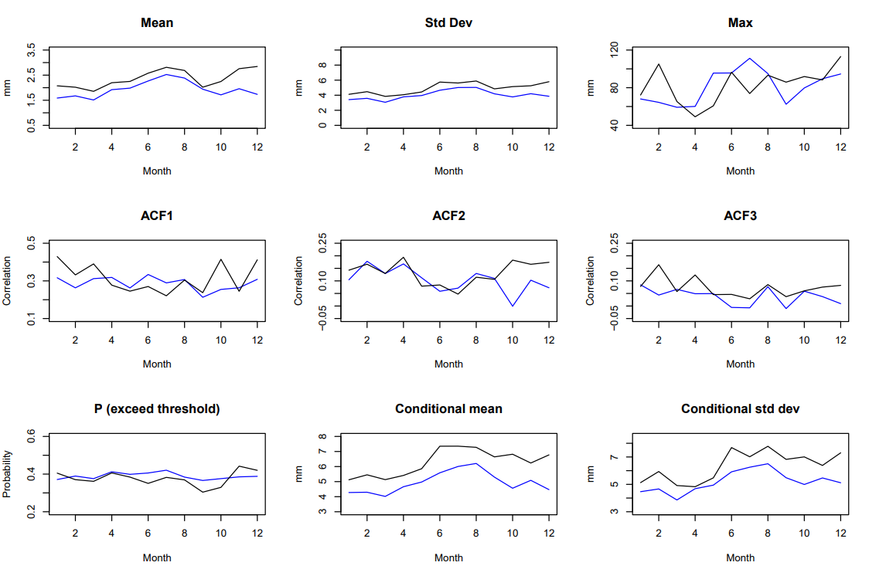
Precipitation Simulation Results from Machine Learning Method
Simulations generally underestimate means, standard deviations, means on wet days, and standard deviations on wet days
Seasonal variations of simulations of maximum, autocorrelation, the proportion of wet days not well captured

Slide 13
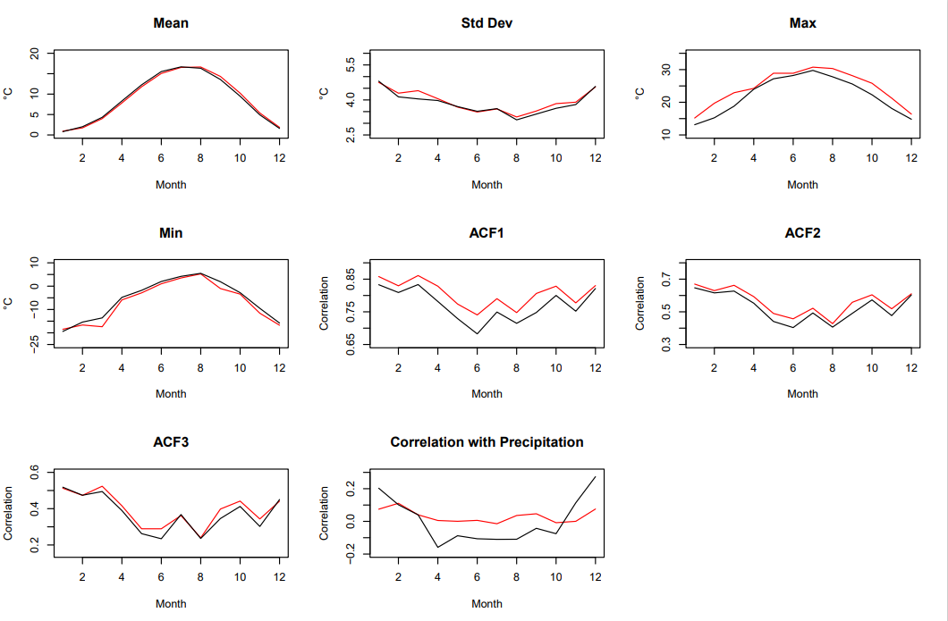
Temperature Simulation Results from Machine Learning Method
Simulated maximums are overestimated, and simulated minimums are underestimated
Simulated autocorrelations are overestimated.
Simulated correlation generally remains unchanged and does not capture the seasonal variations
Simulations of mean and standard deviations generally match the observations well

Slide 14
Comparison between Methods
Simulation Performance:
GLM has a better performance in general, especially for predicting precipitation
Machine learning method has some differences between simulations and observations
Computational efficiency:
GLM takes about 1.5 minutes on a normal computer for 1 simulation.
Machine learning method takes about 4 days on a research computer for 1 simulation.
Requirement for a complete dataset:
GLM does not need a complete dataset
Machine learning method needs a complete dataset
Model Building:
GLM is built manually, which needs human intervention and takes about 2 days to build models
Machine learning method builds models automatically, which takes a few seconds
Relationship between weather variables:
GLM can capture the relationship between variables
Machine learning method cannot capture the relationship between variables

Slide 15
Conclusion
Downscaling: from high-resolution to low-resolution
Aim: compare statistical method and machine learning method for downscaling
Statistical method used: GLM
Machine learning method used: Bayesian network and random forest
Case study: precipitation and temperature series in Rhineland-Palatinate
Comparison: simulation performance, computational efficiency, the requirement for a complete dataset, model-building process, and the relationship between variables

Slide 16
References
Jordans, F. (2021, July 15). Help sent to Germany as over 50 dead, dozens missing in severe European floods. Times of Israel. https://www.timesofisrael.com/help-sent-to-germany-with-over-50-dead-dozens-missing-in-severe-european-floods/
Dierickx, F. (2019, April 28). Copernicus Climate Change Programme: User Learning Service Content. https://bookdown.org/floriandierickx/bookdown-demo/
Chandler, R. E. (2018). RGLIMCLIM: A Multisite, Multivariate Weather Generator Based on Generalised Linear Models. R package version 1.4-0.
Legasa, M.N. and Gutiérrez, J.M., 2020. Multisite Weather Generators using Bayesian Networks: An illustrative case study for precipitation occurrence. Water Resources Research, 56(7), p.e2019WR026416.
Legasa, M.N., Manzanas, R., Calviño, A. and Gutiérrez, J.M., 2022. A posteriori random forests for stochastic downscaling of precipitation by predicting probability distributions. Water Resources Research, 58(4), p.e2021WR030272.
Automatiserad Machine Learning | Softronic AB. (2021, August 11). Softronic AB. https://www.softronic.se/nyheter/automatiserad-machine-learning-fran-vision-till-produktion/

